Slide 1

COVID-19 Radiography Dataset Analysis
Data science capstone project
Brett Gordon
4/23/2023

Slide 2
Agenda
Problem Statement
Data Wrangling and Exploratory Data Analysis
Pre-processing/Modeling
Resolution and Next Steps

Slide 3
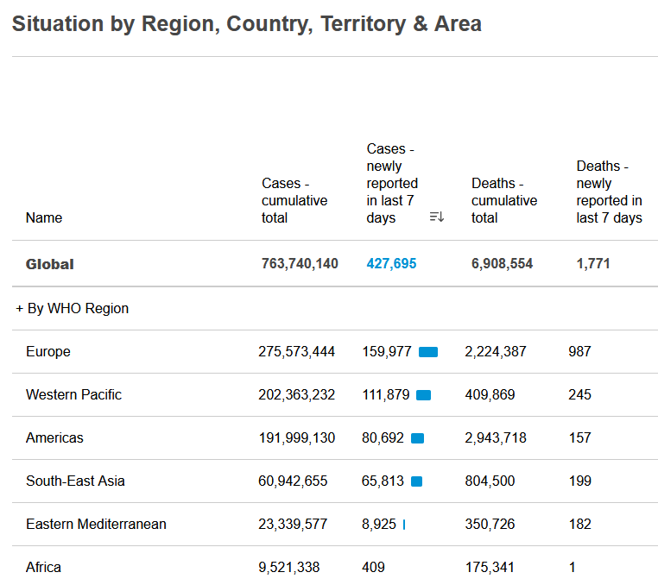
Problem Statement
COVID-19 has become endemic
Part of human society like other ailments
COVID-19 can cause hospitalizations, especially if not treated quickly
Can we efficiently predict if a patient has COVID-19 or a different ailment based off lung X-rays?

Slide 4
Goal and Restraints
Be able to predict an illness (between COPD, COVID-19, pneumonia) or a healthy pair of lungs
Accuracy above 90%
Reliable Recall, Precision, Loss
Use this model to help patients and hospitals across the world
However, COVID-19 is still relatively new
Dataset only contained images from 3 illnesses
Computing power is limited for this model

Slide 5
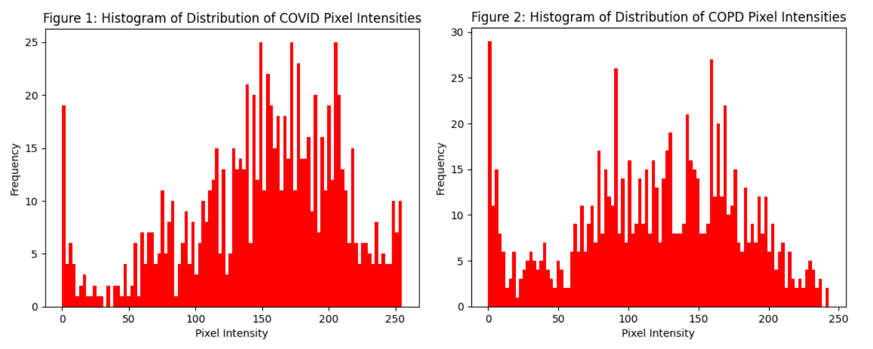
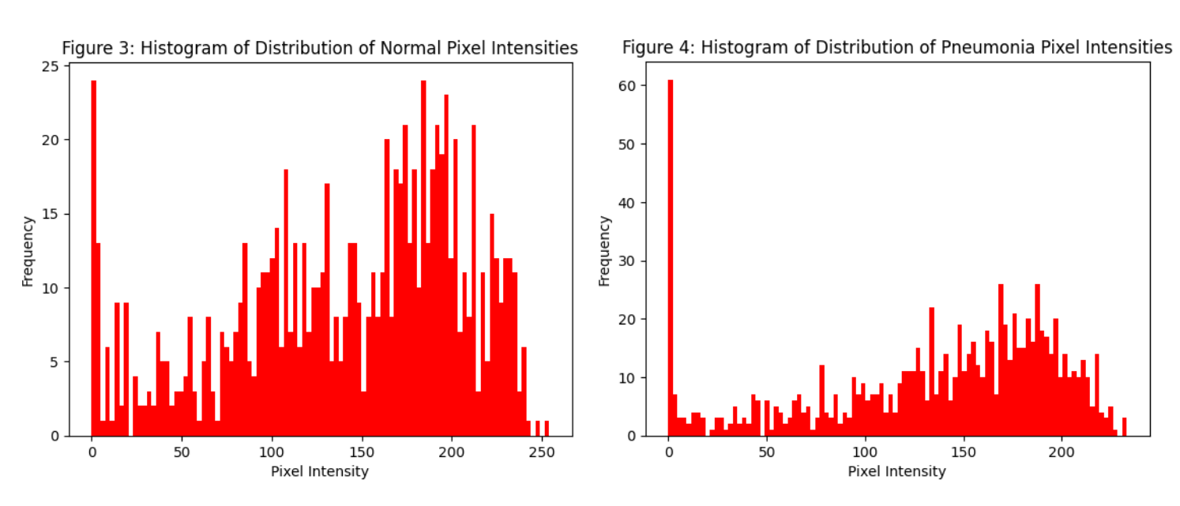
Image Differentiation
Dataset of over 20,000 chest X-ray images
Key column: label
label column used for identifying the ailment
Noticeable pixel distribution from COPD and pneumonia
Might be trouble differentiating COVID and Normal lungs

Slide 6
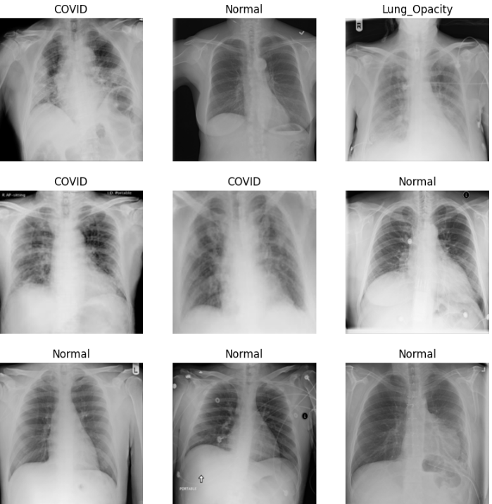
Image Labeling Examples

Slide 7
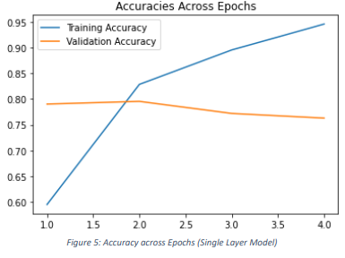
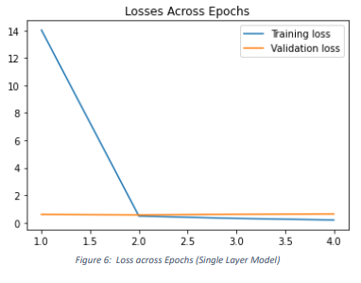
Initial Modeling
Necessary to create a baseline before determining best model
Could only use limited number of images from the dataset
Validation accuracy below 0.8

Slide 8
Image Models Trained/Tested
Used Keras for the remainder of the Modeling Phase
Started with a baseline CNN
Used half the dataset images (over 10,000)
Triple layered CNN
VGG16 Transfer Learning
VGG19 Transfer Learning
ResNet50 Transfer Learning

Slide 9
Convoluted Neural Network Results
CNN Model | Max Epochs | Training Accuracy | Validation Accuracy | Test Accuracy (if applicable)
Triple Layered | 13 | 0.9348 | 0.8256 | NA
VGG16 | 19 | 0.9733 | 0.9266 | 0.9141
VGG19 | 25 | 0.9904 | 0.9822 | 0.9781
ResNet50 | 25 | 0.9333 | 0.9088 | 0.9094
NOTE: VGG19 also had a significantly smaller Training and Validation Loss (0.0294 and 0.0687 respectively)

Slide 10
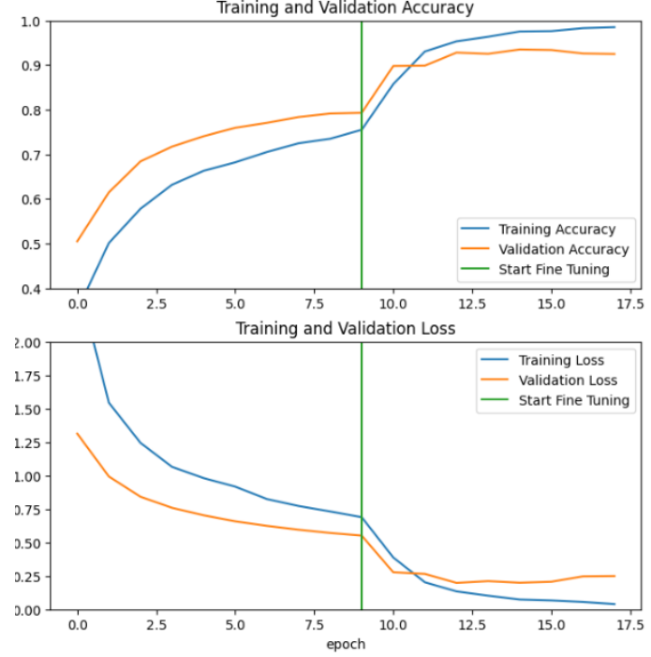
VGG19 Final Results
Training
Accuracy: 0.9852
Loss: 0.0397
Precision: 0.9853
Recall: 0.9846
Validation
Accuracy: 0.9250
Loss: 0.2490
Precision: 0.9272
Recall: 0.9246
Test Accuracy: 0.9203
F1 Score: 0.9259
NOTE: Had to use limited epochs due to computing limitations, thus lower accuracy and higher loss from previous model

Slide 11
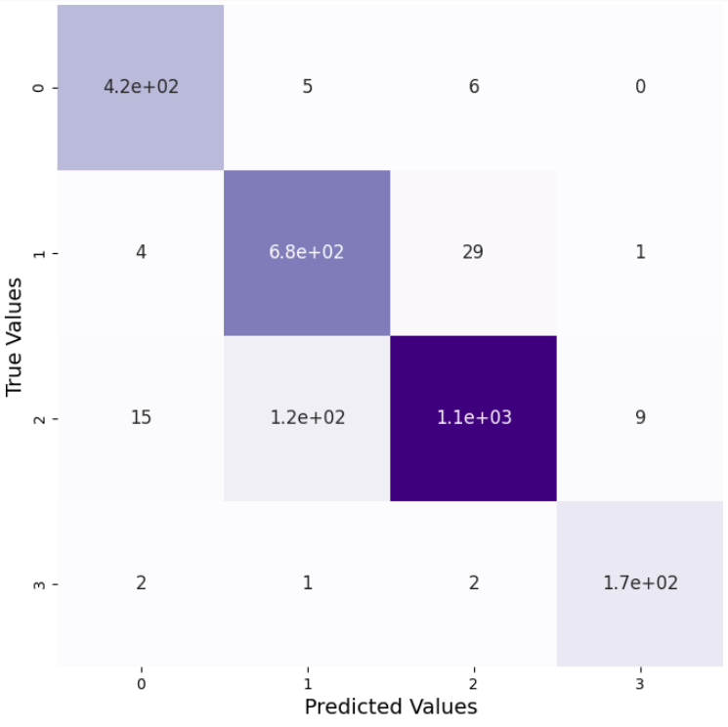
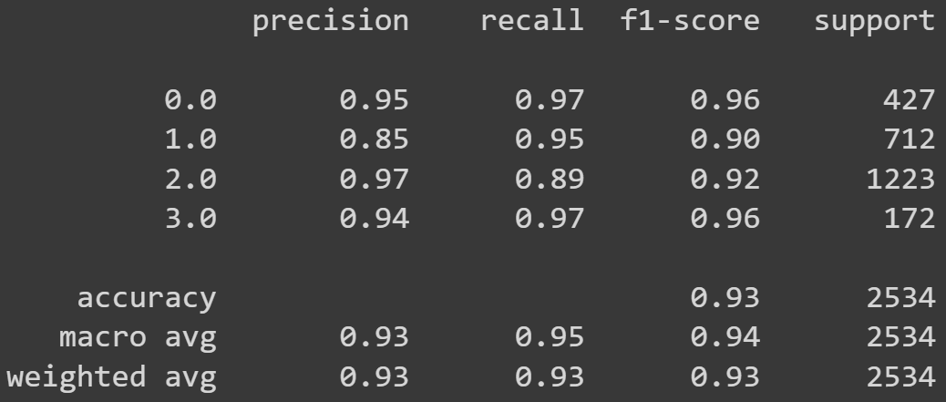
VGG19 Classification Report and Confusion Matrix

Slide 12
Next Steps/Future Research
Continue using VGG19 Transfer Learning primarily
Add different ailments that can be noticeable in chest X-rays to the dataset
Gain access to larger computing power to train and validated against larger datasets
Focus on improving the precision/recall between healthy and not healthy lungs
Vital to not treat healthy patients and vice versa

